Slide 1
CHARTING THE COURSE OF INNOVATION
A STARTUP ANALYSIS

Slide 2


Slide 3
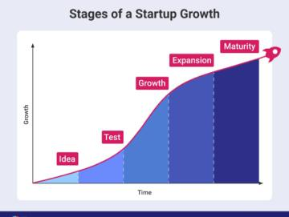
CONTENTS
Introduction
Project Objective and Constraint
Empathy and Brainstorming Map
Dataset Explanation
Data Description
Future Scope
Conclusion

Slide 4
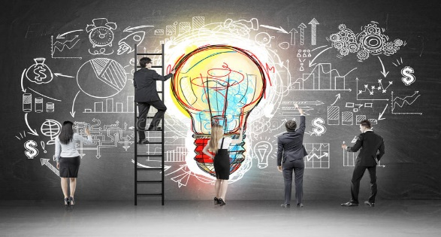
INTRODUTION
The term startup refers to a company in the first stages of operations. Startups are founded by one or more entrepreneurs who want to develop a product or service for which they believe there is demand.
Startups can use seed capital to invest in research and to develop their business plans. Market research helps determine the demand for a product or service, while a comprehensive business plan outlines the company's mission statement, vision, and goals, as well as management and marketing strategies.
Startups must also consider where they will do business and their legal structure.
For example, a technology startup selling virtual reality hardware may need a physical storefront to give customers a face-to-face demonstration of the product’s complex features.

Slide 5
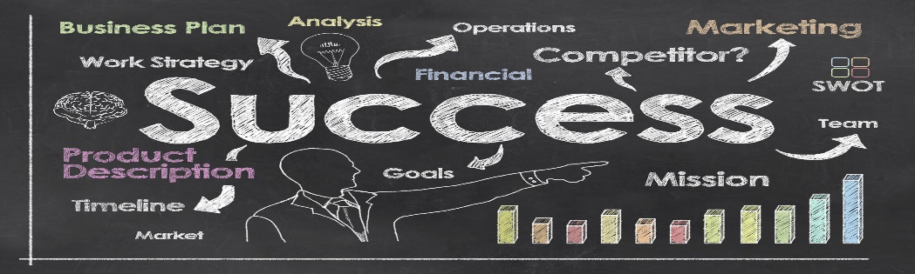
PROJECT OBJECTIVE AND CONSTRAINT
Unrealistic Expectations.
Hiring Suitable Candidates.
Patnership Decision Making.
Winning Trust of Customers.
Control and manage both existing and new markets.
The objectives are the major goals that you want your startup to achieve in any quarter. The key results are defined under each of the objectives and these are actionable and measurable steps that can be taken to complete that objective.

Slide 6
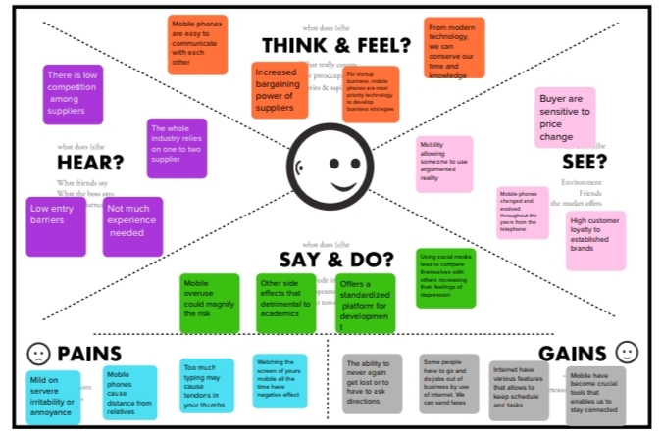
EMPATHY MAP

Slide 7
STEP-1:TEAM GATHERING AND SELECTHE PROBLEM STATEMENT.
TEAM GATHERING:
We discuss our topic “CHARTING THE COURSE OF INNOVATION-A STARTUP ANALYSIS”.
SET THE GOAL:
Collect more relevant information about our topic and make it as Brainstorming and Idea Prioritization model.
LEARN HOW TO USE THE FACLITATION TOOLS:
By the help of mentor, we understand all these things.

Slide 8
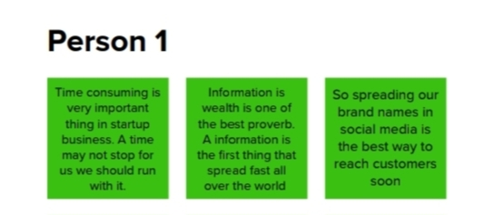
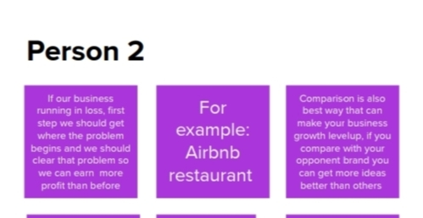
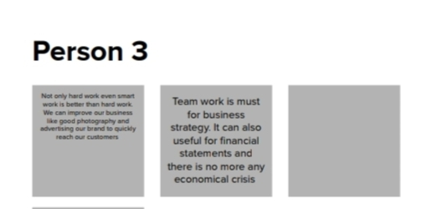
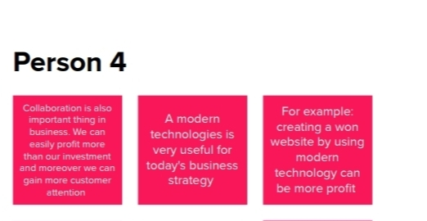
STEP-2: BRAINSTORM, IDEA LISTING AND GROUPING

Slide 9
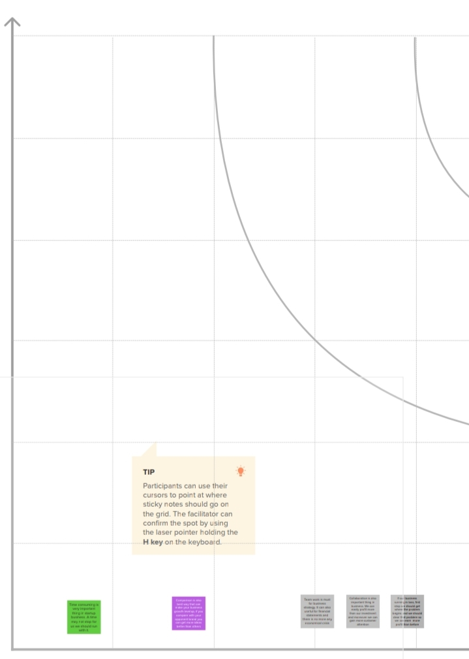
STEP-3: IDEA PRIORITIZATION

Slide 10
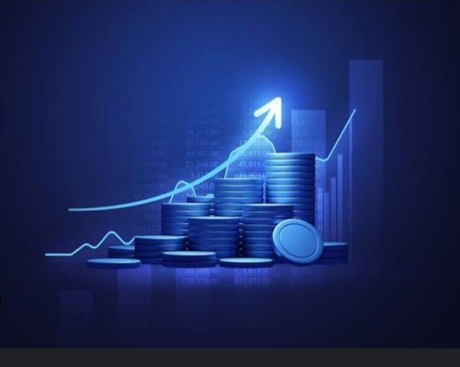
DATASET EXPLANATION
There are several types of datasets available for startup analysis. Here are a few common datasets that can be used for startup analysis:
AngelList: AngelList is a platform that connects startups with investors. This dataset can be used to identify potential investors and track funding rounds.
Social Media: Social Media platforms such as Twitter, Facebook and Instagram provide a wealth of data on consumer behavior, trends, and sentiment. This dataset can be used to understand consumer behavior and preferences.
Overall, the choice of dataset will depend on the specific research question and the type of startup being analyzed. A combination of datasets may be necessary to gain a comprehensive understanding of a startup and its industry.

Slide 11
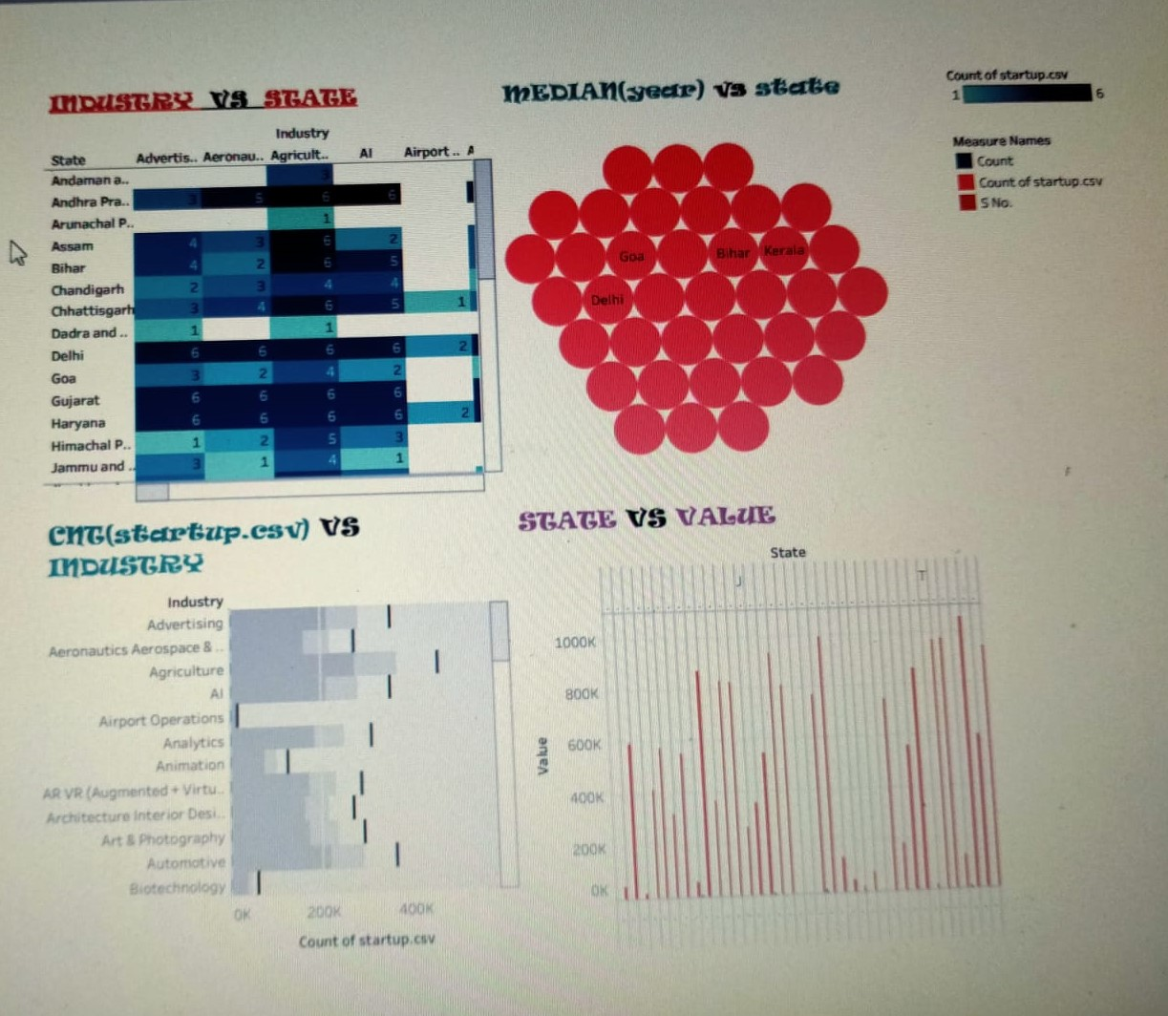
DASHBOARD-STARTUP ANALYSIS

Slide 12
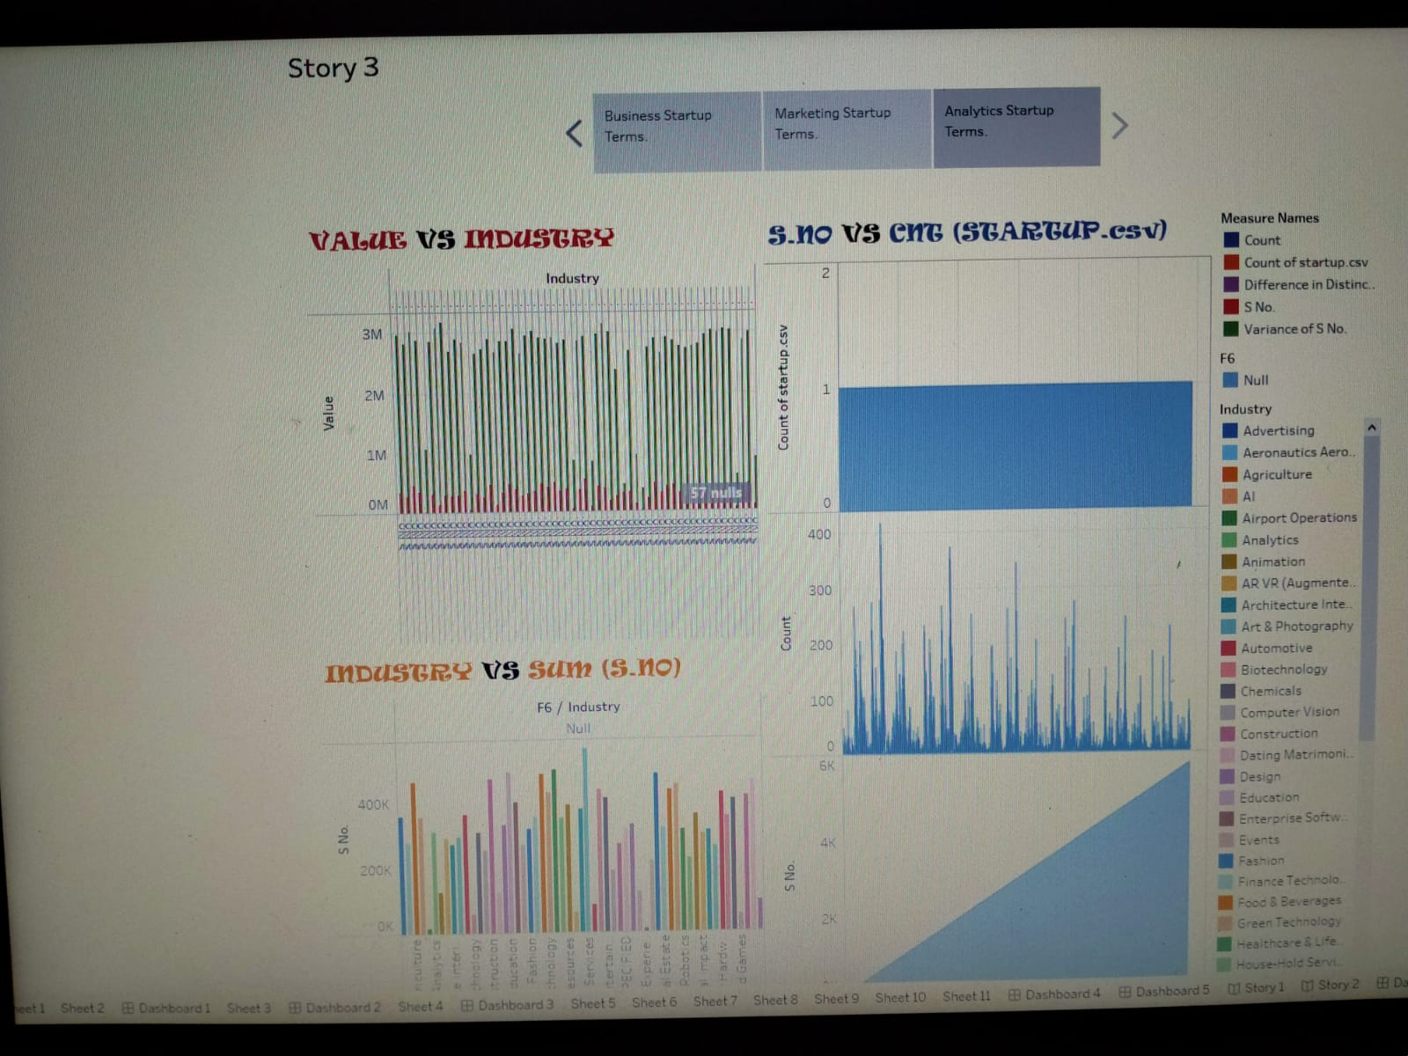
STORY-STARTUP ANALYSIS

Slide 13
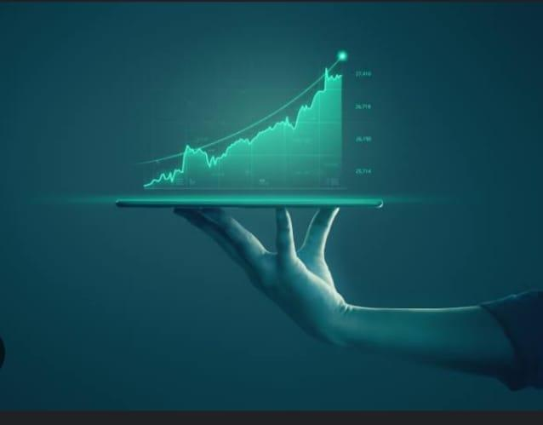
FUTURE SCOPE
The future scope for startup analysis is quite broad, as the startup ecosystem is constantly evolving and changing. Here are a few potential areas where startup analysis could expand in the future:
Artificial Intelligence(AI) and Machine Learning(ML)-With the growing availability of data and the rise of AI technologies, startup analysis could leverage these tools to generate more accurate predictions and insights about the market and competition.
Predictive Analysis- With the use of machine learning and advanced algorithms, startup analysis could predict future trends and market shifts. This could help investors identify emerging startups to adjust their strategies accordingly.
Overall, the future of startup analysis is likely to involve more data-driven approaches and expanded criteria for evaluating startups beyond just financials and traditionals marketing analyses.

Slide 14

CONCLUSION
While the world-changing potential in startups is sometimes overhyped, successful startups do have the potential to create a significant positive impact on the world. And even when startups fail, they still have an impact, especially through the learnings for the founders, employees, investors and other stakeholders.
Tesla, for example, has led the way in redefining the entire car industry. Ten years ago electric cars seemed at best an oddity, but now they look a great deal like the pioneering spirit of Tesla, the car industry itself would have been very unlikely to take this new direction.

Slide 15

THANK YOU

